Slide 1
Creating Screenshots
Guide to creating screenshots acceptable for submission to OIM & omb

Slide 2
Table of Contents
This guide will provide instructions and helpful tips on creating screenshots of collection instruments that are acceptable for submission to OIM and OMB. Remember, these screenshots must be legible and only include relevant information. These screenshots are posted to OMB’s public facing website so they must look professional.
Do’s and Don'ts for submitting a screenshot
How to use the Windows Snipping Tool
How to create a Full-screen screenshot
Examples of admissible screenshots
Examples of inadmissible screenshots

Slide 3
Do’s and Don’t’s
DO | DON’T
Ensure the OMB/ RCS control number or placeholder is visible in the screenshot Include the Agency Disclosure Notice in the screenshot Redact PHI/PII Use ‘test’ data Ensure clarity of the screenshot | Include PHI/PII (e.g. SSN, personal information) Include browser tabs or other irrelevant information in the screenshot Submit blurry or illegible screenshots Omit or cut off questions/ data

Slide 4
How to use the Windows Snipping Tool
Open the Windows Snipping Tool (search ‘snipping tool’ in Windows)
Select ‘New’ to select the area you would like to capture using your cursor
Save the image
Snipping Tool Icon
Tip: Hover your cursor on the above image and press play to view a demonstrative video

Slide 5
How to create a full-screen screenshot
Open the Snipping Tool
Select ‘Mode’, then select ‘Full-screen Snip’
Save the image
Alternatively, use the keyboard shortcut Alt + PrtScn. The screenshot is then saved to the clipboard and can be pasted into a document
Tip: Hover your cursor on the above image and press play to view a demonstrative video

Slide 6
Example of an Admissible Screenshot (Standard Instrument)
Displays OMB control number
Includes Agency Disclosure Notice & Privacy language
Displays test data (i.e not a real patient’s info)
PHI/PII is redacted

Slide 7
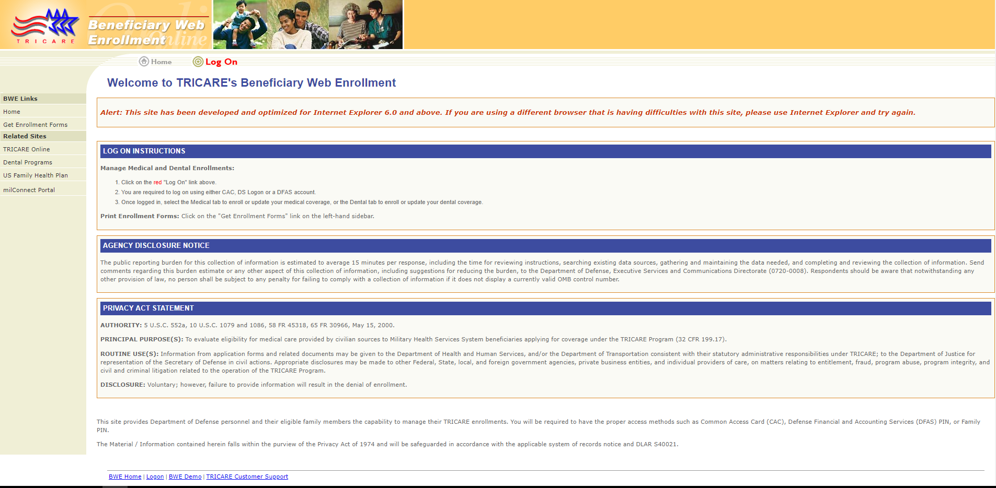
Example of an Admissible Screenshot (System)
Displays the ADN and Privacy Act Statement as it appears to the respondent
*Pro Tip: For systems with multiple screenshots, submit the screenshots as PowerPoint or PDF document in sequential order (i.e. display the system screens in the order the respondent would view/access it)

Slide 8
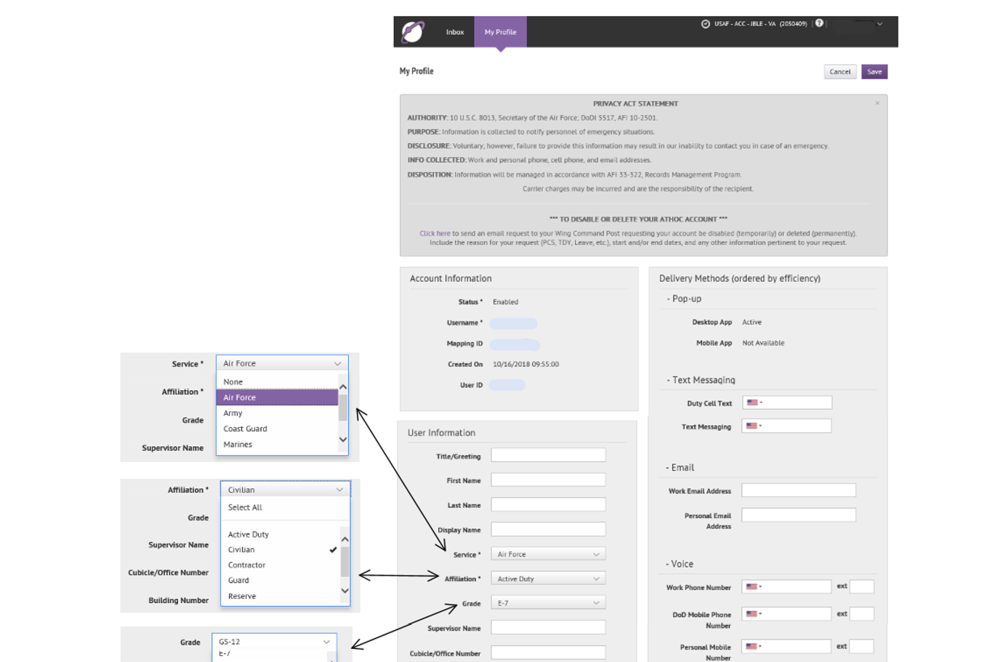
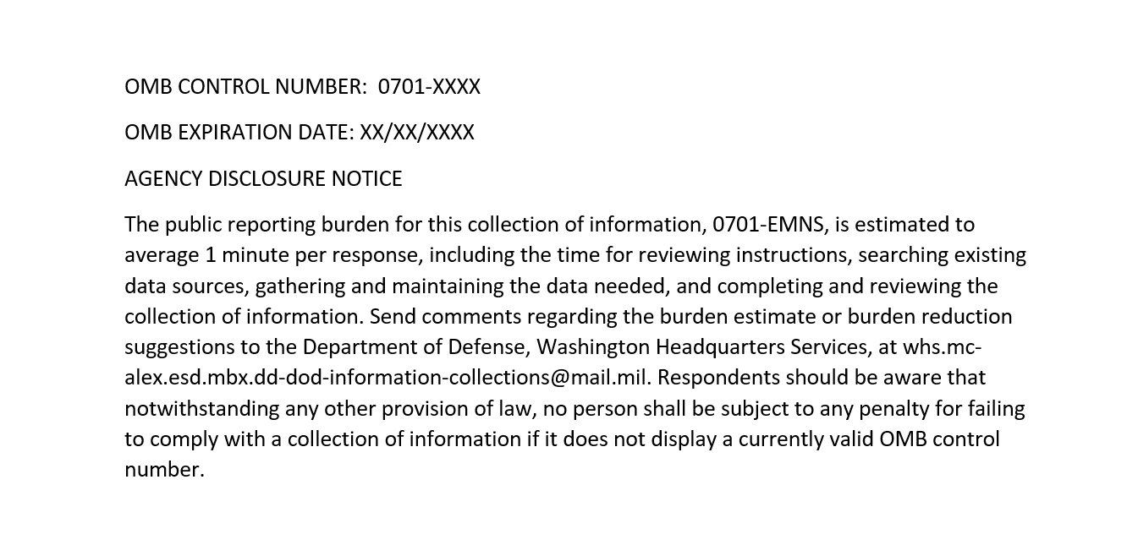
Example of an Admissible Screenshot (Draft System)
Just like any other ICR where the collection instrument is a draft, you can submit a draft of your system! If you are submitting a new ICR and the system is not yet finalized, submit "draft" screenshots. Create a document (preferably PowerPoint or PDF) that outlines how the system will appear to respondents. Be sure to display placeholders for the OMB Control Number, ADN, and PAS.
These screenshots are of a recent submission to OMB (0701-XXXX), of the Emergency Mass Notification System. The component provided a document displaying all the fields of data to be captured, and also provided a draft of their ADN and placeholders.

Slide 9
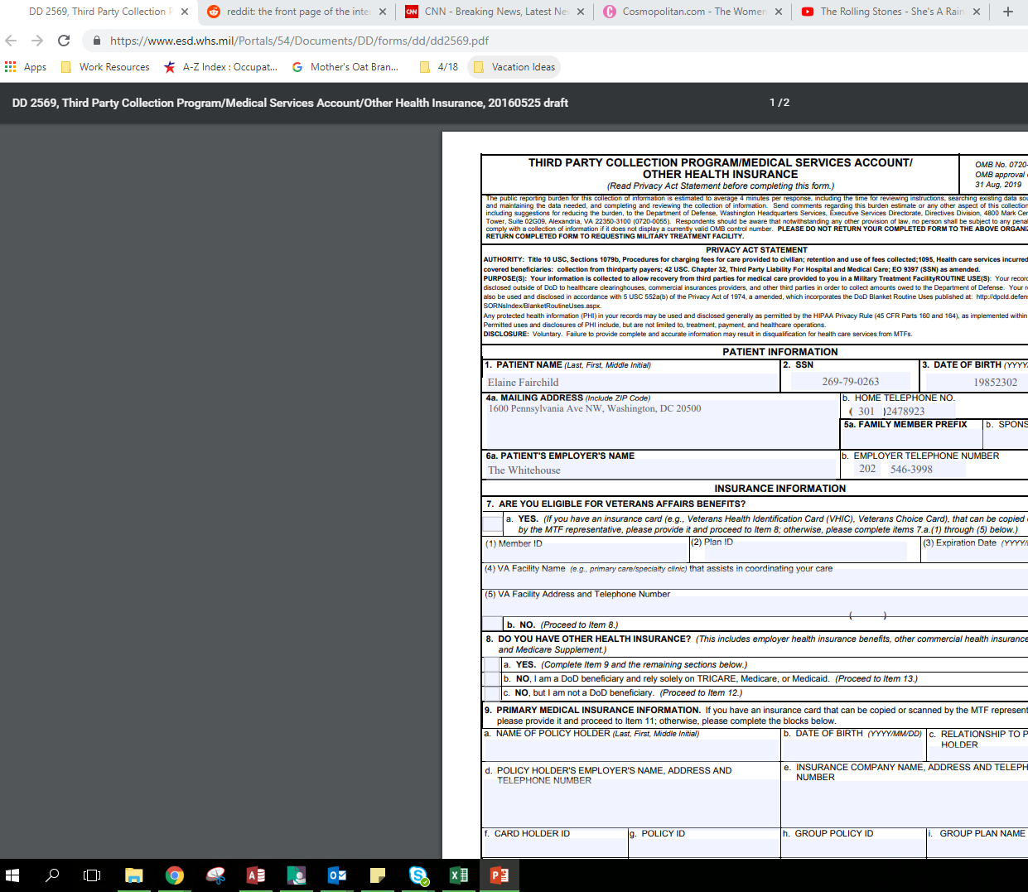
Example of an Unacceptable Screenshot
Irrelevant tabs & bookmarks visible
Control number & compliance information is cut off
Screenshot overall is blurry and difficult to read
PII is displayed

Slide 10
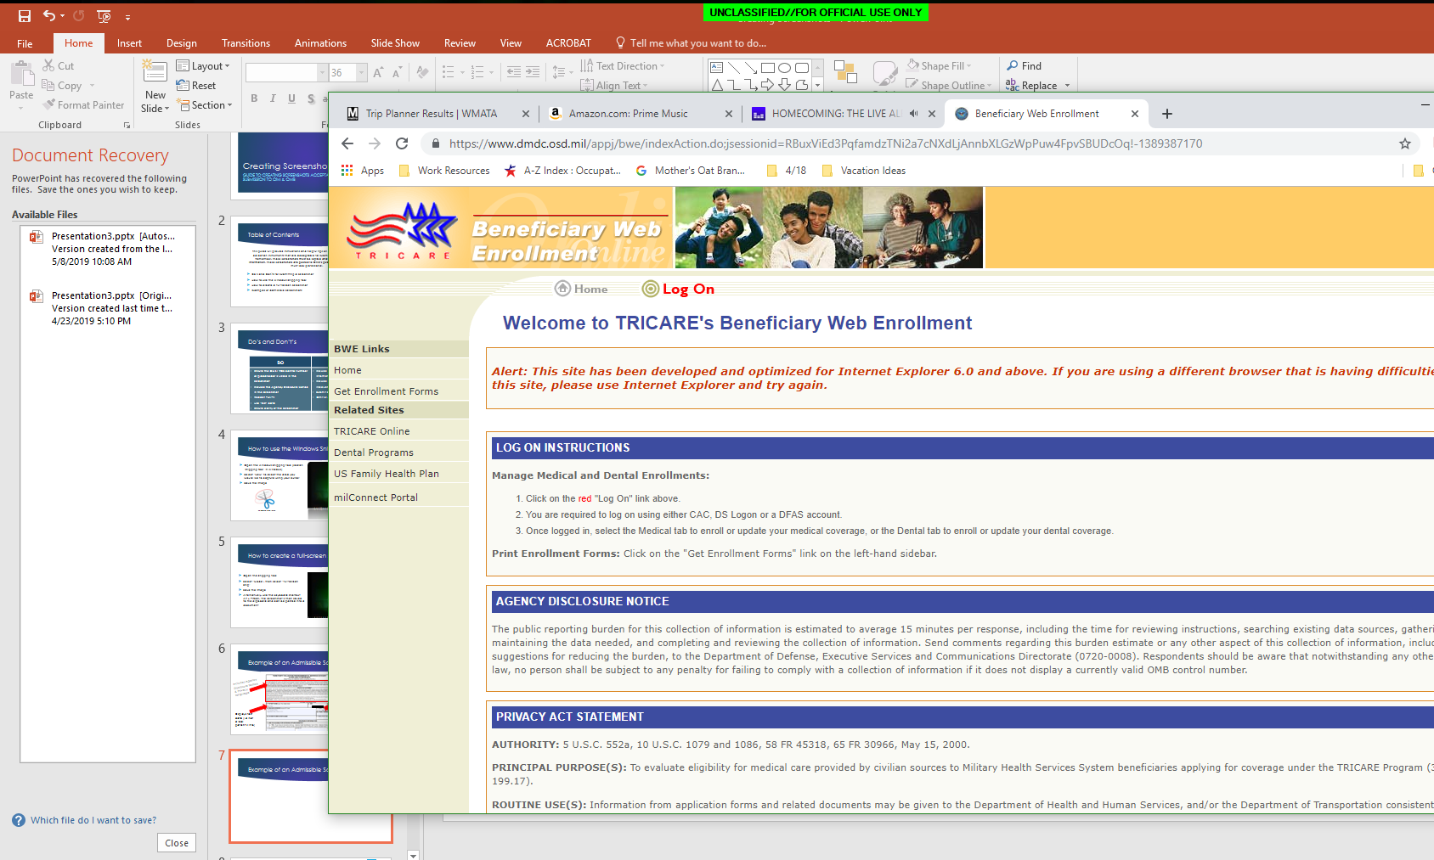
Example of an Unacceptable Screenshot
This screenshot displays irrelevant information, is not legible and parts of the important information (ADN, PAS) are cropped out

Slide 11
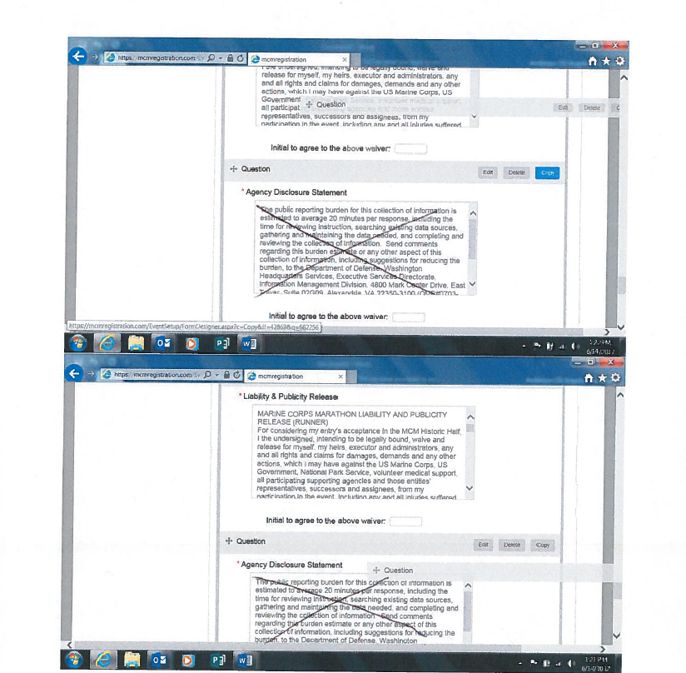
Example of an Unacceptable Screenshot
These ‘screenshots’ are difficult to read
Obvious these were printed, written on and scanned
The link in the browser of the screenshots directs to an out-of-date and corrupted website containing explicit images

